Slide 1
Location-Based Personalized Advertisements (Los Angeles) Jiewei Gao

Slide 2
Final Project
Introduction/Business Problem
Data acquisition
Exploratory Data Analysis
Methodology
Result
Conclusion

Slide 3
Introduction / Business Problem
Marketing is essential for every business.
Ads and commercials are feasible ways to present your products or service to audience.
Audience prefer being presented with information that they are really interested.
Problem: How can your ads be distributed to interested parties including customers with more precision and less cost?

Slide 4
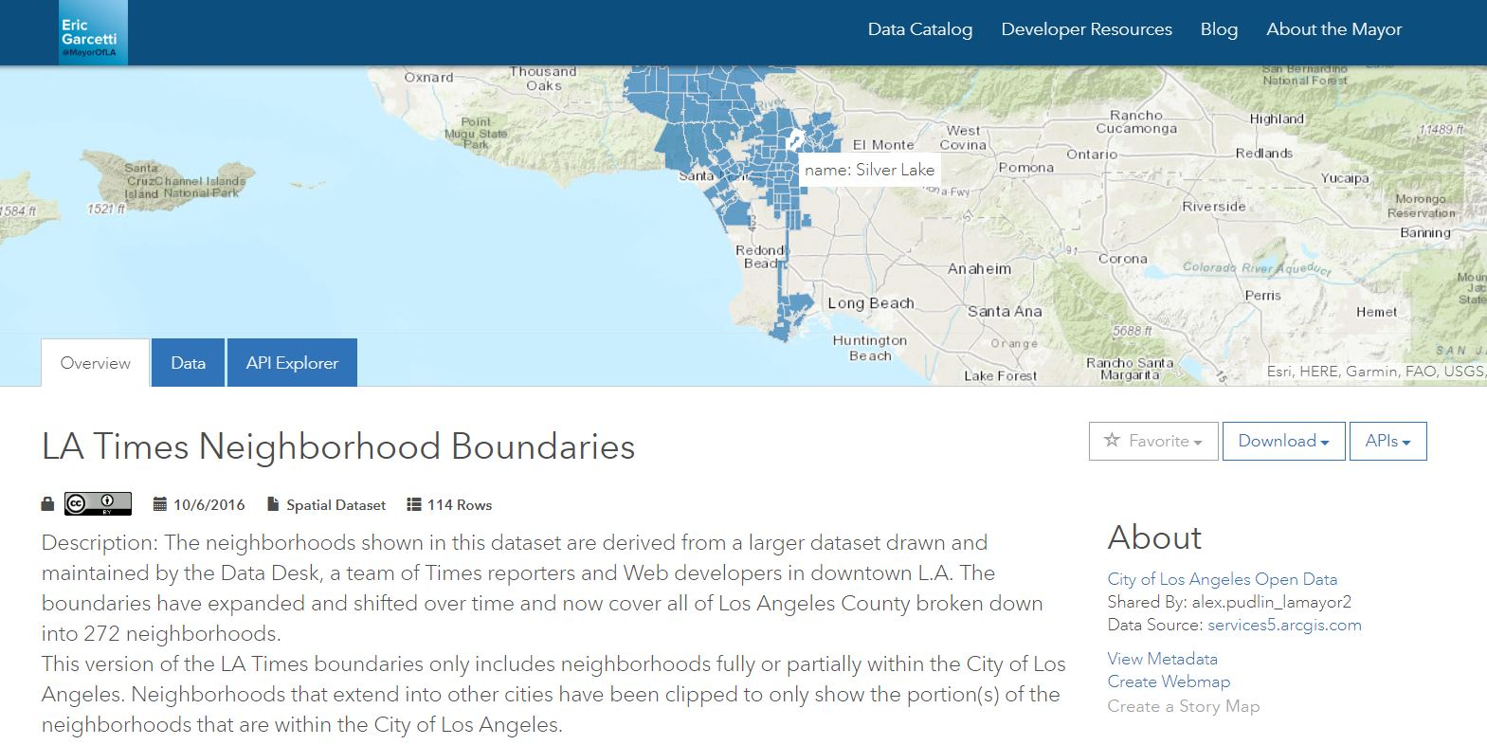
Data acquisition
Neighborhoods Data: LA Times – “Mapping L.A Boundaries API”
Venues information: Foursquare API

Slide 5
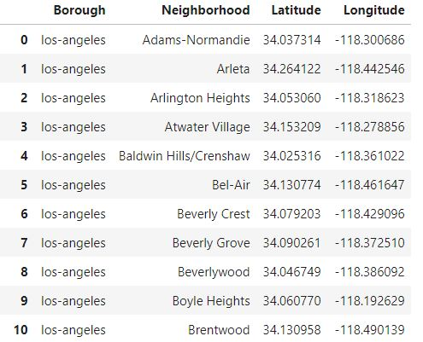
Exploratory Data Analysis
113 neighborhoods in Los Angeles and their coordinates are displayed.
Place your screenshot here

Slide 6
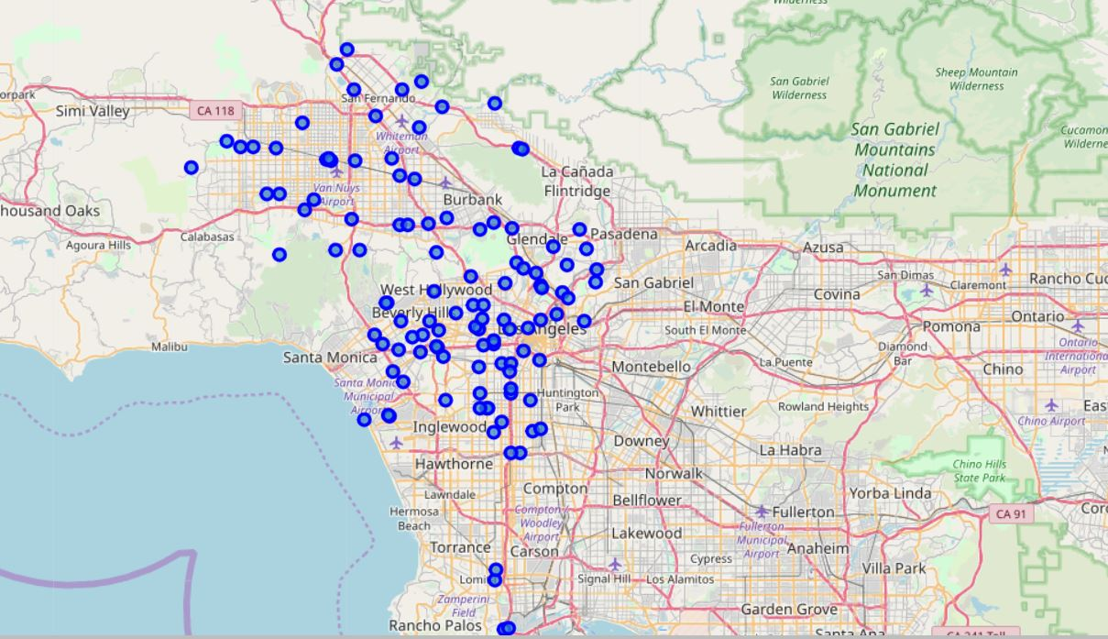
Exploratory Data Analysis
113 neighborhoods in Los Angeles and their coordinates are displayed;
Place your screenshot here

Slide 7
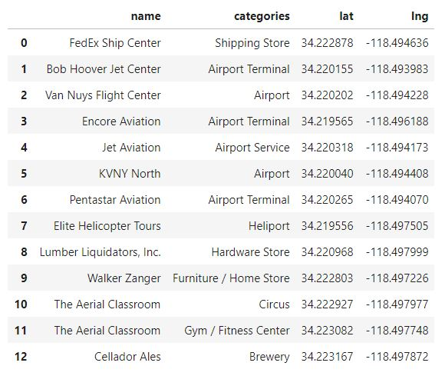
Exploratory Data Analysis
Take ‘North Hills’ as example and generate top 20 venues of it.
Place your screenshot here

Slide 8
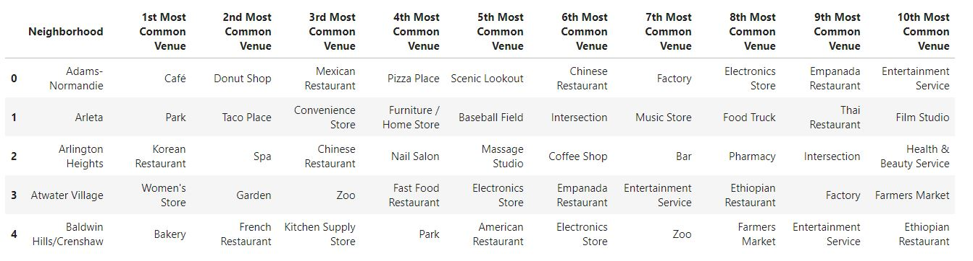
Methodology
One-hot encoding
Clustering:
K-means Clustering;
DBSCAN (Density-Based Spatial Clustering of Applications with Noise).

Slide 9
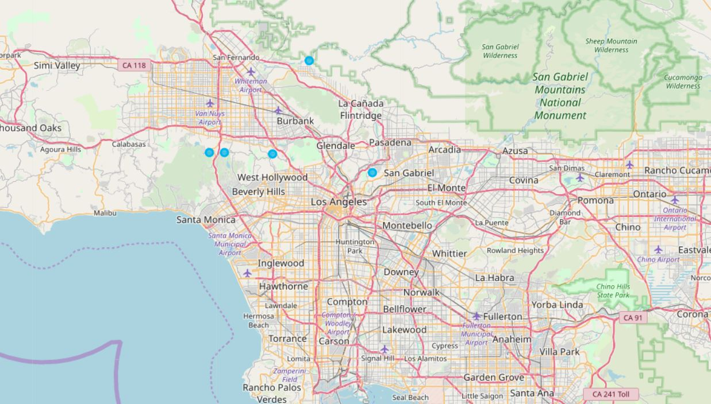
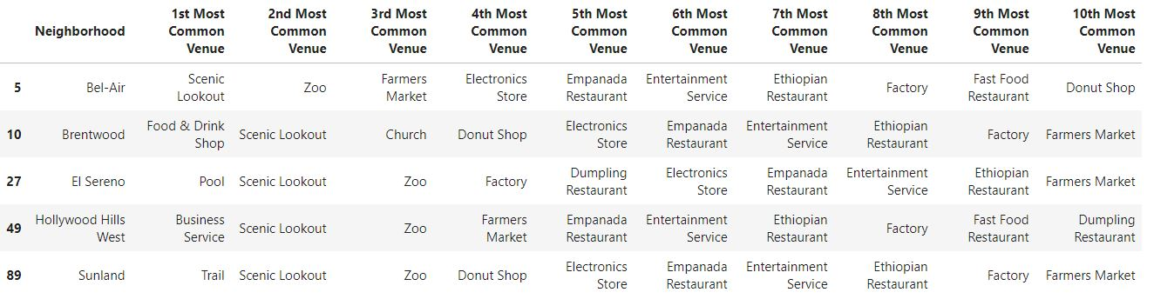
Result
Cluster 1
Scenic Lookout/ Zoo

Slide 10
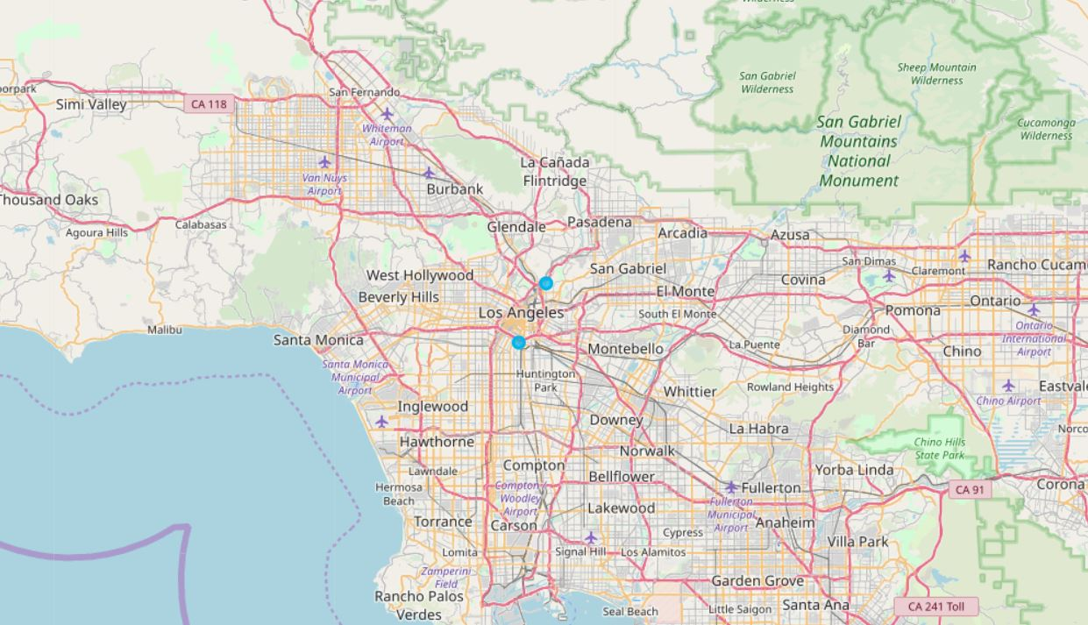
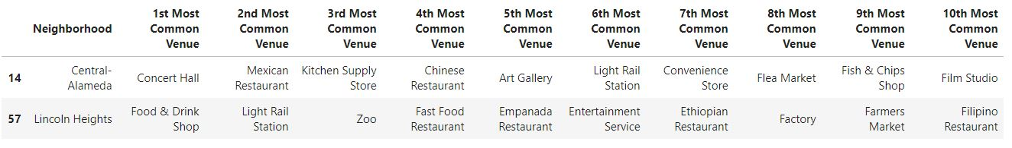
Result
Cluster 2
Scarce data in one cluster

Slide 11
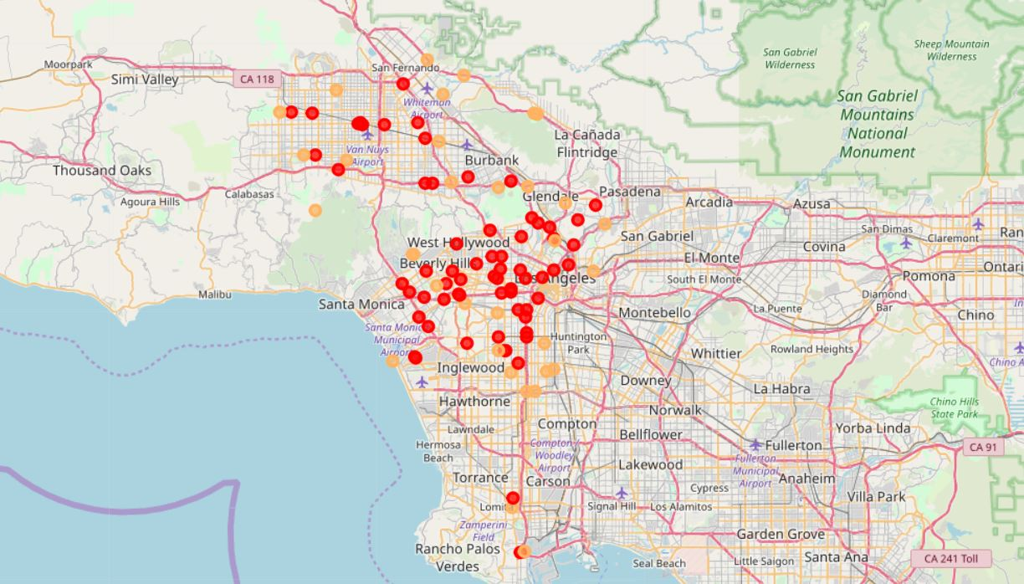
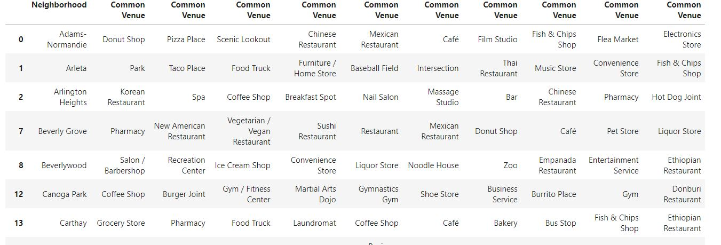
Result
Cluster 3
After using DBSCAN,
Red plots represent new cluster data and Yellow plots are considered noises.

Slide 12
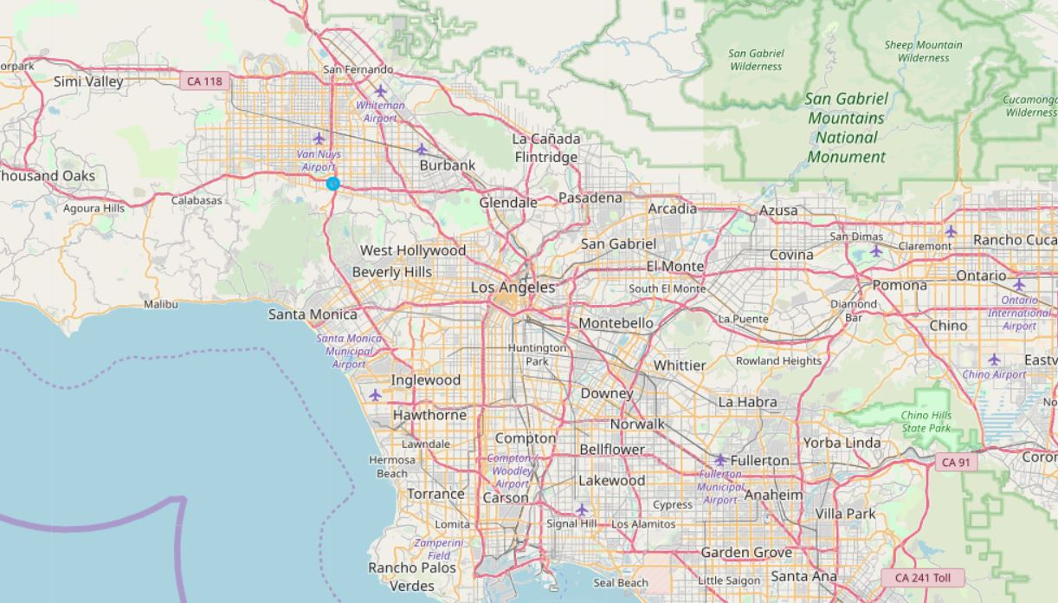
Result
Cluster 4
Scarce data in one cluster

Slide 13
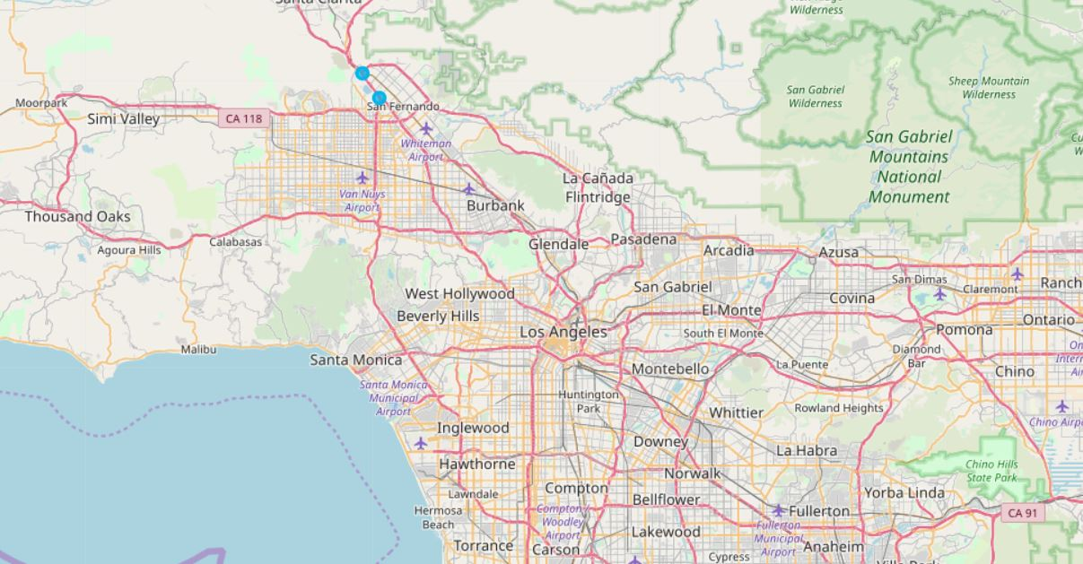
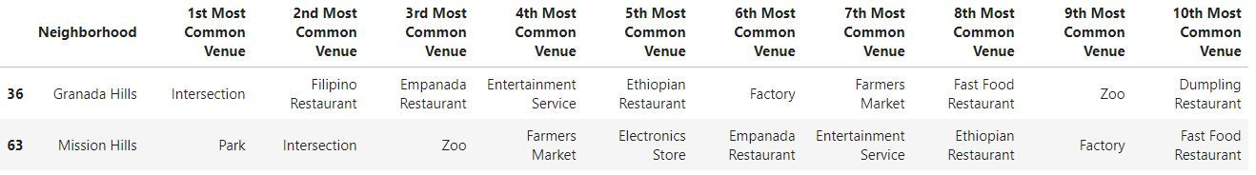
Result
Cluster 5
Scarce data in one cluster

Slide 14
Conclusion
Analyze the neighborhoods of Los Angeles, use K-mean clustering to generate clusters and then use DBSCAN to further improve the cluster quality.
In this way, we can target personalized ads at neighborhoods that have the same category as the ads or neighborhoods that are in the cluster which also has the same category.
More precision of clustering leads to less cost and more efficiency of personalized ads targeting.

Slide 15
Thanks!
Any questions?
Feel free to find me at
neverjerryko@gmail.com

